Slide 1


A Mini Project on
“ SMART HEALTH: ADVANCED HEART DISEASE
PREDICTION USING MACHINE LEARNING”
Presented By
1. 1. Saad Inamdar & Roll No.59
2. Arshad Perampalli & Roll No.65
Class : T.Y. Sem.-I
Under the guidance of
Prof. A. S. Adhatrao
Department of Artificial Intelligence & Data Science
N.K. Orchid College of Engineering & Technology, Solapur.
2024-2025

Slide 2
Contents
Introduction
Literature Review
Motivation and Problem statement
Requirement Analysis
Design
6. Implementation
7. Result and Discussion
8. Conclusion

Slide 3
Introduction
Heart disease is still a major cause of illness and death around the world, making it important to have better tools for early detection and prevention.
This study uses machine learning to predict the risk of heart disease by analyzing a variety of patient data, including personal, medical, and lifestyle information, and using algorithms logistic regression.
The study finds that machine learning can more accurately predict heart disease than traditional methods and can help develop personalized healthcare solutions.

Slide 4
Literature Review
Khare et al. (2020) used logistic regression to analyze clinical features such as blood pressure, cholesterol levels, and blood sugar, achieving over 85% accuracy on widely used datasets.
Kumar et al. (2022) compared logistic regression with decision trees, support vector machines (SVM), and ensemble methods.
Patel et al. (2021) highlighted the importance of transparency in clinical decision-making, which logistic regression provides by showing the contribution of individual features.

Slide 5
Motivation and Problem statement
Heart disease remains one of the leading causes of mortality worldwide, emphasizing the urgent need for accurate and early prediction methods.
Logistic regression, with its simplicity and interpretability, provides a practical tool for identifying individuals at risk by analyzing critical health parameters.
The primary challenge lies in effectively leveraging this model to handle diverse patient data while balancing predictive accuracy and computational efficiency.

Slide 6
Requirement Analysis
Front-end: Streamlit
Backend: Python
Application: VS-CODE
Hardware: Computer System , Memory , Networking Hardware
Technologies: Machine Learning Frameworks, Python Libraries ,IDE

Slide 7
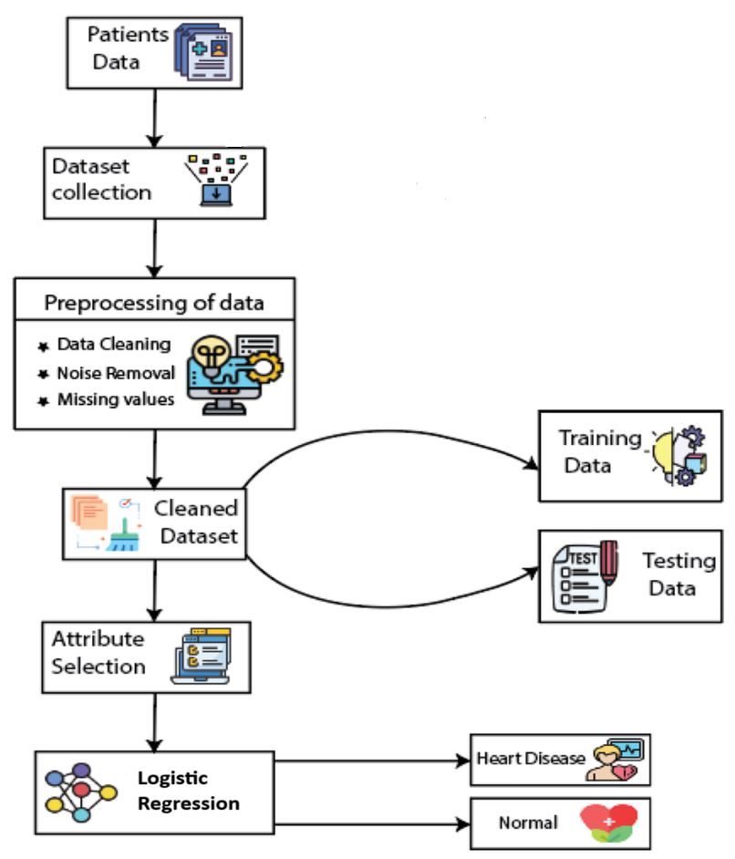
Design

Slide 8
Implementation
Dataset Collection
Data Preprocessing
Train the Logistic Regression Model
Make Predictions
Evaluate the model
Simple UI
Test the Model

Slide 9
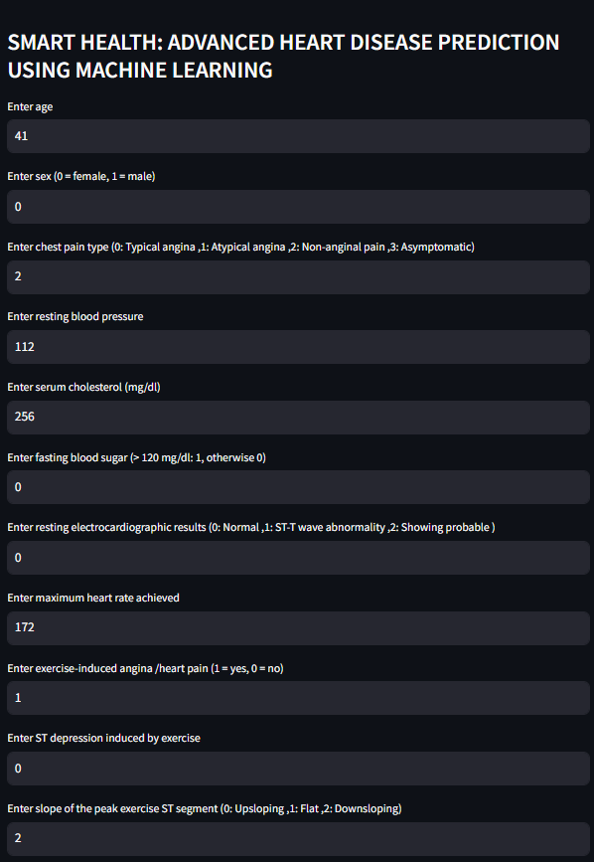
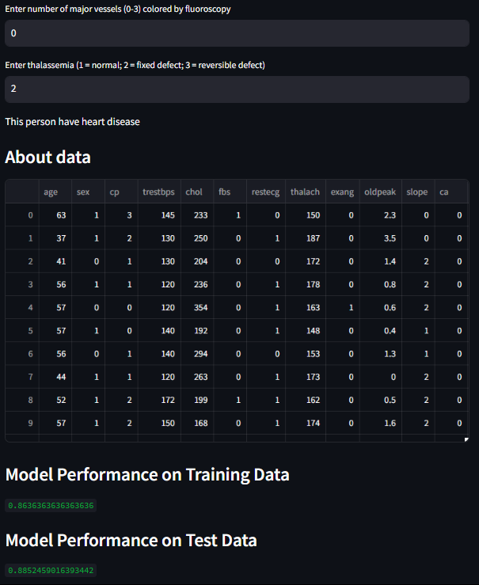
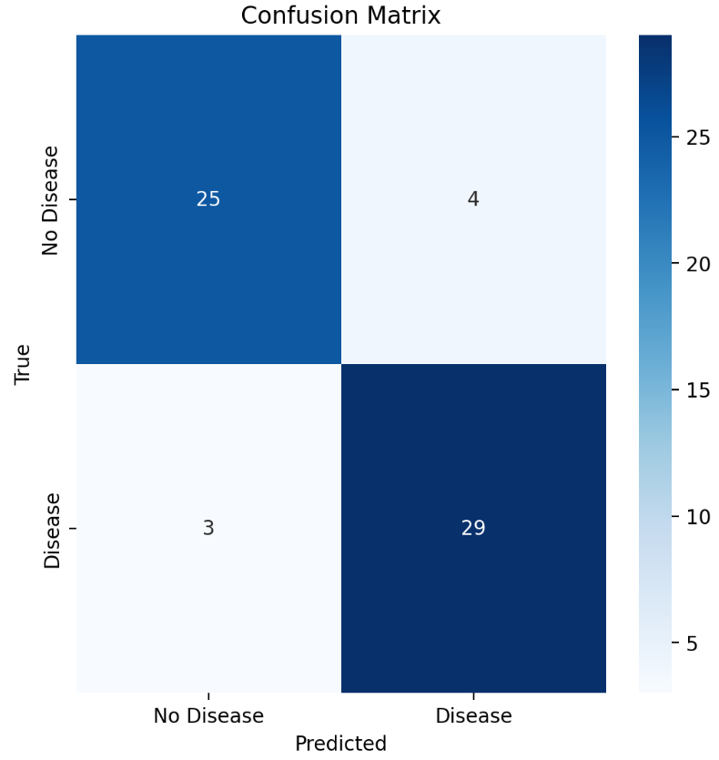
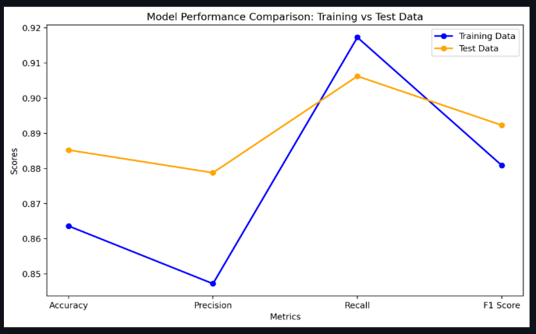
Result and Discussion

Slide 10
Conclusion
logistic regression proves to be an effective tool for predicting heart disease by analyzing key factors such as age, cholesterol levels, and blood pressure.
The model offers a clear understanding of how various variables contribute to the likelihood of heart disease, providing valuable insights for early diagnosis and intervention.
However, further refinement and the inclusion of more diverse data could enhance the model's accuracy and generalizability for broader applications.

Slide 11

THANK YOU

